Slide 1
Battle Of Neighbourhoods
Prateek Shamprasad Pawar
Email: prateekspawar@gmail.com

Slide 2
Introduction
Tom wants to relocate from ‘Parkwoods , Toronto’ to New York.
Problem is to find similar neighbourhood.
Factors Identified:
1) Plenty of Shops and Services making daily life easy.
2) A great number of food venues available.
3) Good transportation services.
4) Less Nightlife spots in the neighbourhood.

Slide 3
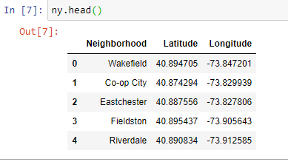
Data ( New York)
1)New York Neighbourhoods geospatial data (.json):
https://geo.nyu.edu/catalog/nyu_2451_34572 .
2)Extract data using json.load() .
3) Append Data in ny DataFrame.

Slide 4
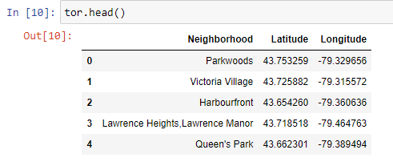
Data (Toronto):
1)Toronto postal code data for neighbourhoods:
https://en.wikipedia.org/wiki/List_of_postal_codes_of_Canada:_M .
2)Toronto coordinates of postal codes:
https://cocl.us/Geospatial_data/Geospatial_Coordinates.csv .
3) Combine to get tor DataFrame.

Slide 5
1. Acquiring Venues Data
Coordinate Data
Foursquare API
Venues Data

Slide 6
2. Defining Categories:
1.Arts & Entertainment
2.College & university
3.Event
4.Food
5.Nightlife Spot
6.Outdoors & Recreation
7.Professional & Other Places
8.school
9.Residence
10.Shop & Service
11.Travel & Transport

Slide 7
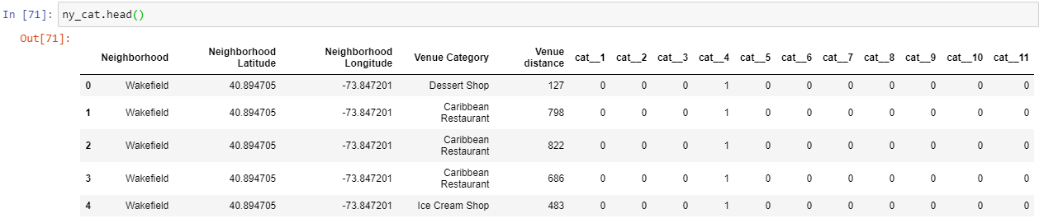
3. One-Hot Encoding:
Adding Dummy columns of each category and converting category data to binary.

Slide 8
4,5. Data conditioning and Grouping
Condition:
If the distance is less than 500 m the influence remains 1.
If the distance is more than 500m the influence becomes 0.5.
Grouping:
Using Neighbourhoods to group dataframes.
The category data for each neighbourhood gets added.

Slide 9
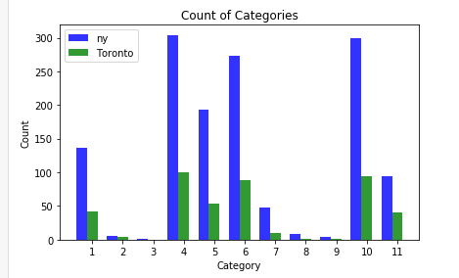
6. Category Selection:
The categories 2,3,8,9 are neglected.

Slide 10
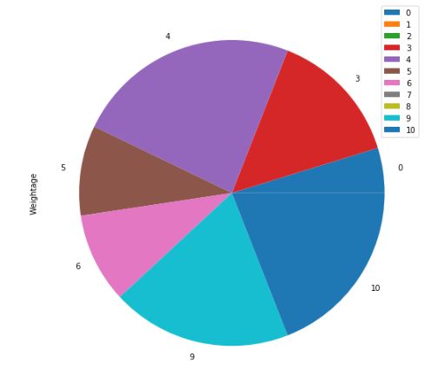
7. Category Weightage:
No | Category | Weight
1 | Arts & Entertainment | 0.05
2 | College & university | 0
3 | Event | 0
4 | Food | 0.15
5 | Nightlife Spot | -0.20
6 | Outdoors & Recreation | 0.10
7 | Professional & Other Places | 0.10
8 | school | 0.0
9 | Residence | 0.0
10 | Shop & Service | 0.20
11 | Travel & Transport | 0.20

Slide 11
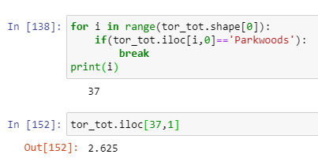
8. Total Score:
Total score is weighted sum of all the categories in the neighbourhood.
The dataframes are arranged in descending order of Total score.
The total score is parameter to define compatibility of Tom’s family in given neighbourhood.

Slide 12
9. Conditional Separating:
Separating the New York neighbourhoods in three dataframes:
1) Neighbourhoods having more Total score than ‘Parkwoods’.(ny_up)
2) Neighbourhoods having same Total score as that of ‘Parkwoods’. (ny_same)
3) Neighbourhoods having less Total score than ‘Parkwoods’.(ny_down)

Slide 13
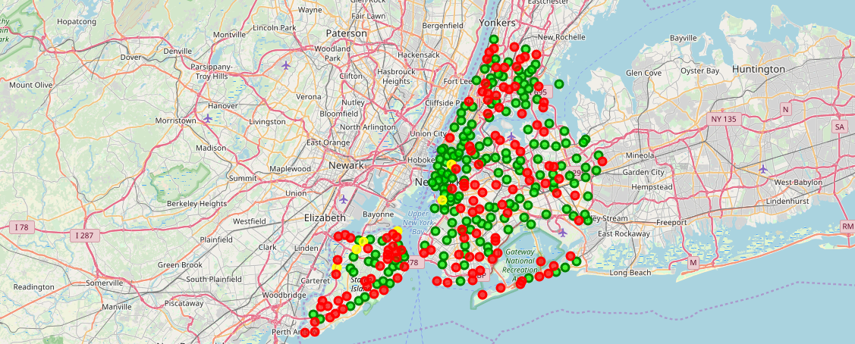
Result
ny_up | Green
ny_same | Yellow
ny_down | Red

